Slide 1

Onions Preservation and Monitoring Team Members Mohnish Kumaar D (20BPS1152) Dechen Dorji (20BPS1156)

Slide 2
Outline
Onion is extraordinarily crucial now no longer most effective as a vegetable however additionally as a forex earner among different end result and vegetables. Onions can rot or decay due to the continuous change in the climate. Therefore, onions ought to be preserved through retaining the temperature given through the National Onion Association (NOA). Under the ambient condition, the onions are saved at temperature zero to 4°C with humidity 60 to 70%.
In this project, we will design an onion conservation system, which will preserves the onions in a prescribed manner. In this machine temperature and humidity sensors will be used to reveal temperature and humidity, respectively. Using the Peltier module, the air within the tank is cooled and warmed to preserve the same standard temperature range. By the usage of the Internet of Things (IoT), making the proposed machine clever and efficient, the consumer will get notification of the machine anywhere in the world. Also, customers will get latest onion marketplace trends.

Slide 3
Objective
Preserve onions from rotting and decaying during rainy seasons owing to the continuous change in the climatic conditions in India.
To sense the ammonia gas, temperature, and humidity with the help of the LM35 temperature sensor, gas sensor MQ 137, and send SMS alerts to mobile numbers stored inside the Arduino program, if onion quality is selected using global system for mobile communication (GSM).

Slide 4
Introduction
Losses in stored onion in Maharashtra is higher because of onion bulbs are having better water content. It is expected that out of the full manufacturing of forty one lakh tones of onion, forty to 50% worth greater than Rs. six hundred crores are misplaced because of desiccation, decay, and sprouting in garage. This outcomes in a upward push of their charge to the 4 to 5 times. India produces all 3 kinds of onion, viz., red, yellow, and white. The manufacturing, as well as, marketplace cost of this potential vegetable is increasing day by day. This states that onion desiccation, rotting, rooting, decay, and sprouting in onion storage sheds must be avoided. Onion is extraordinarily crucial not only for vegetable internal but additionally as the best forex earner amongst the fruits and vegetables. Onion farmers are looking to increase manufacturing 12 months after 12 months. However, onion charge has been distinctly unstable and more recently the charge has been sluggish. This has resulted in the Maharashtra State Agriculture Marketing Board seeking price support.

Slide 5
Literature Review
The post-harvest onion storage methodology is designed and implemented to reduce its degradation. Onion harvesting detection is done using Arduino, LM35 temperature sensor, humidity sensor, gas sensor, and GSM module. The objectives of this quality of onion using Arduino is to sense the ammonia gas, temperature, and humidity with the help of the LM35 temperature sensor, gas sensor MQ 137, and send SMS alerts to mobile numbers stored inside the Arduino program, if onion quality is selected using global system for mobile communication (GSM). This project will help the user to control such parameters affecting positive feedback against different onion losses.

Slide 6
Shed net is used here because it improves the thermal behavior significantly decreasing the inside temperature. The system works on the principle of sensing emitted gases by onions and attempting to control them within the desired parameter range of temperature and so humidity and also gives an online record observation facility. In this novel methodology, a system is introduced, which is an IoT based food monitoring system.
In this system, sensors related to food safety, like CO2, humidity, and nitrogen sensing elements are used, and IoT plays an important role as it gives the alert to users at a remote location.

Slide 7
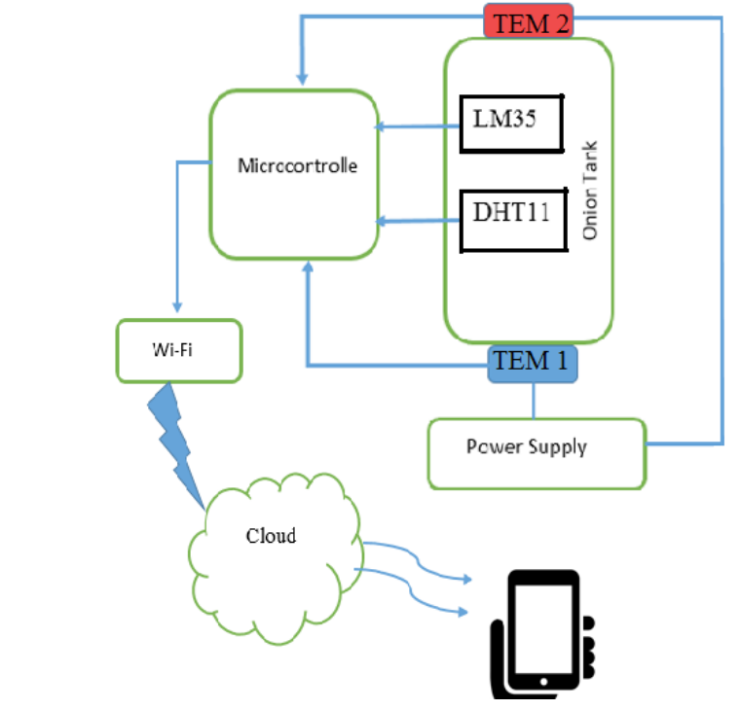
Architecture

Slide 8
Thank You!

